Slide 1




Bridging Gender Gaps in Financial Literacy with Personalized Recommender Systems
Presented by :
Abbie Opendah
SCT213-C002-0027/2021
BSC DATA SCIENCE AND ANALYTICS
28/05/2025

Slide 2




Introduction
Financial literacy—the ability to manage money effectively—is vital in today’s economy.
However, women consistently score lower than men due to systemic barriers like limited access to education, cultural norms, and economic constraints.
These gender gaps hinder informed decision-making and limit women's economic empowerment.
This project aims to address this issue by building a personalized recommender system that suggests actionable financial education content based on individual needs.

Slide 3

Problem Statement
Most financial education programs use a one-size-fits-all approach that overlooks women’s unique needs and barriers. This results in low engagement, poor outcomes, and persistent gender gaps in financial literacy.
Personalized learning makes content more meaningful, increases participation, and enhances knowledge retention—especially for groups often excluded from traditional financial education.

Slide 4



Objectives of the Project
To identify and analyze the financial literacy gaps and unique needs of different genders through data analysis.
To design and implement a personalized recommender system tailored for financial education, considering the unique learning needs and preferences of different genders.
Promote financial empowerment by helping users make informed and confident financial decisions.

Slide 5


Dataset Overview
Source: Financial Literacy Survey Dataset (based on OECD methodology)
Sample Size: Over 125,000 respondents across multiple regions
Target Group: Adults from various countries with a focus on gender-disaggregated data
Key Variables Include:
Gender
Age, Education Level
Access to Internet
Financial Knowledge, Behavior, and Attitudes
Digital Financial Literacy Scores
Purpose of Dataset:
To analyze financial literacy levels and identify personal attributes that influence financial knowledge and behavior, enabling personalized recommendations.

Slide 6




Data Preprocessing
Purpose: To clean and prepare raw data for effective modeling and recommendations.
To ensure robust analysis for the financial literacy recommender system, I meticulously prepared the data. This involved addressing missing information, converting categorical data into numerical formats, identifying the most influential variables, and standardizing numerical features for accurate comparisons.
Why It Matters:
Clean, well-structured data improves the accuracy of the recommender system and ensures personalized recommendations are meaningful and reliable.

Slide 7


Exploratory Data Analysis
Our analysis revealed key insights into financial literacy:
Gender Gap: Women consistently demonstrated lower digital financial literacy scores than men, confirming a significant gender disparity.
Score Distribution: Most adults fall into the mid-range of financial literacy, indicating widespread opportunities for improvement.
Influencing Factors: Higher education, internet access, location(Urban vs Rural) and employment are strong predictors of better financial literacy.
These patterns are crucial for tailoring personalized recommendations to enhance user engagement and effectiveness.

Slide 8


Recommender System Approach
This project uses a content-based filtering approach to build the personalized financial education recommender system. The system analyzes each user's personal attributes—such as gender, education level, financial behavior, attitudes, internet access, and their digital financial literacy score—to generate tailored content suggestions.
By calculating cosine similarity between user profiles and content features, the system identifies the most relevant learning materials for each individual. This method ensures that users receive recommendations that closely align with their specific needs and characteristics, improving both engagement and learning effectiveness.

Slide 9
System Architecture
The recommender system follows a structured flow that transforms user data into personalized financial education recommendations:
User Input:
The system collects user information such as gender, education level, location, and access to the internet.
Feature Extraction:
Relevant features are selected and converted into numerical form for analysis.
Profile Matching:
The user profile is compared to content profiles using cosine similarity to identify the best matches.
Content Recommendation:
The system outputs a list of personalized financial education
resources tailored to the user's profile.
This architecture ensures accurate, relevant, and meaningful recommendations by focusing on individual characteristics.

Slide 10
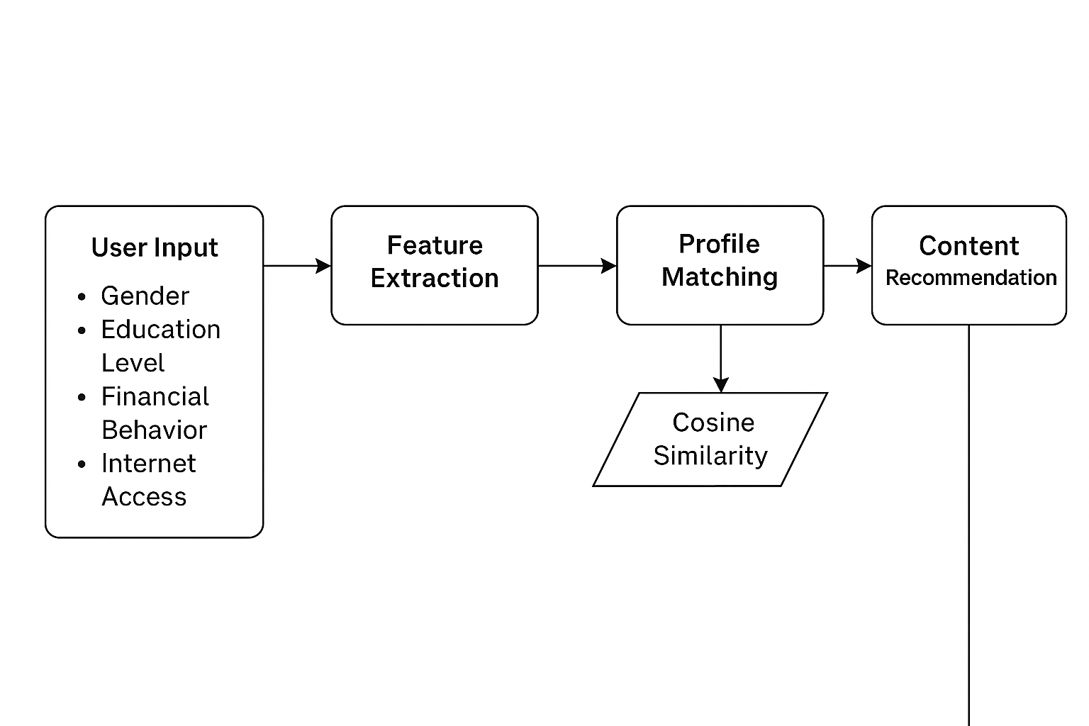
Content Based Recommendation System Architecture

Slide 11
How the Sysem Personalizes the Recommendations
Feature Selection
Key user attributes selected: age, gender, employment status, financial goal, preferred investment,, and literacy level.
One-Hot Encoding
Converted categorical features into numerical format using OneHotEncoder to enable similarity calculations.
Similarity Matrix
Used cosine similarity to compute how similar each user is to others based on encoded features.
Recommendation Function
recommend_products function finds similar users and suggests their associated "RecommendedProduct" to the target user.
Evaluation Metrics: Precision & Recall
Precision : Proportion of recommended items that are relevant
Recall : Proportion of relevant items that are recommended

Slide 12
Challenges Faced
The dataset only contains aggregated group statistics (like average scores by gender or age), not personal responses needed to build user-specific profiles.
When a new user joins, there's no historical data about their preferences or interactions, making it difficult to provide relevant recommendations.
Recommender systems often rely on collecting vast amounts of granular user data. This raises significant privacy concerns, especially with regulations like GDPR.
It's challenging to quantify the success of a financial education recommendation. Is it knowledge gain, improved financial behavior, or achievement of financial goals? Measuring these outcomes is complex.

Slide 13

Conclusion: Driving Financial Empowerment
The personalized recommender system is designed to be a powerful tool in closing financial literacy gaps.
The system specifically targets and effectively addresses gender gaps by providing tailored financial education. It's not a one-size-fits-all approach; it's about meeting individuals where they are.
By offering personalized content, the system dramatically improves user engagement. When financial information is relevant and accessible, users are more likely to interact with it, learn from it, and apply it.

Slide 14
Thank You
Q And A Session
Presented by :
Abbie Opendah
SCT213-C002-0027/2021
BSC DATA SCIENCE AND ANALYTICS
28/05/2025

Slide 15
GIT HUB REPOSITORY
Final Year Project Repository
System Link

